Slide 1

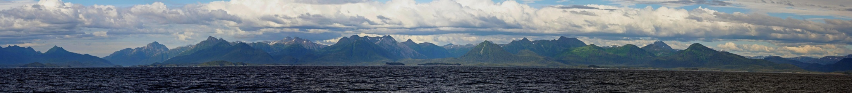
Gulf of Alaska
Integrated Ecosystem Research Program
aka The Gulf of Alaska Project
NOAA Fisheries

Slide 2
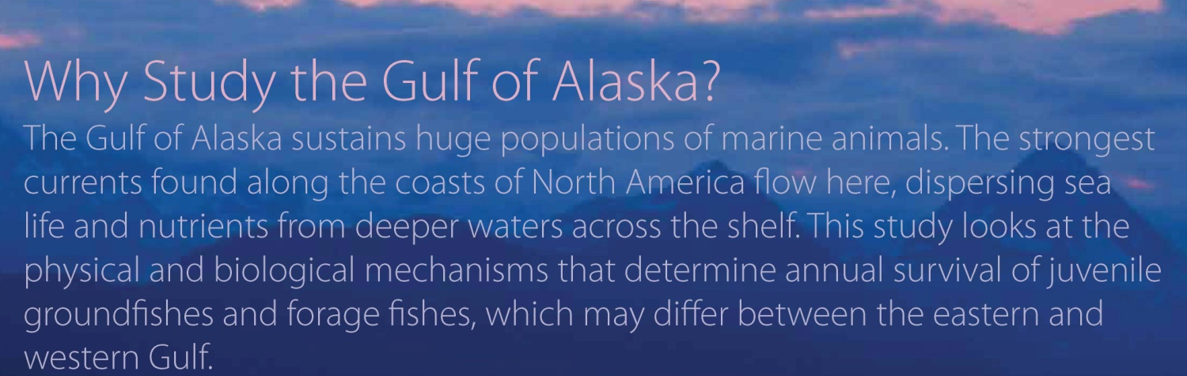

Interdisciplinary study
  >40 scientists from 11 institutions
  5 years (2010 – 2014)
  $17.5 million-study
Gauntlet for groundfishes
  Sablefish
  Walleye pollock
  Pacific ocean perch
  Pacific cod
  Arrowtooth flounder
NOAA Fisheries

Slide 3
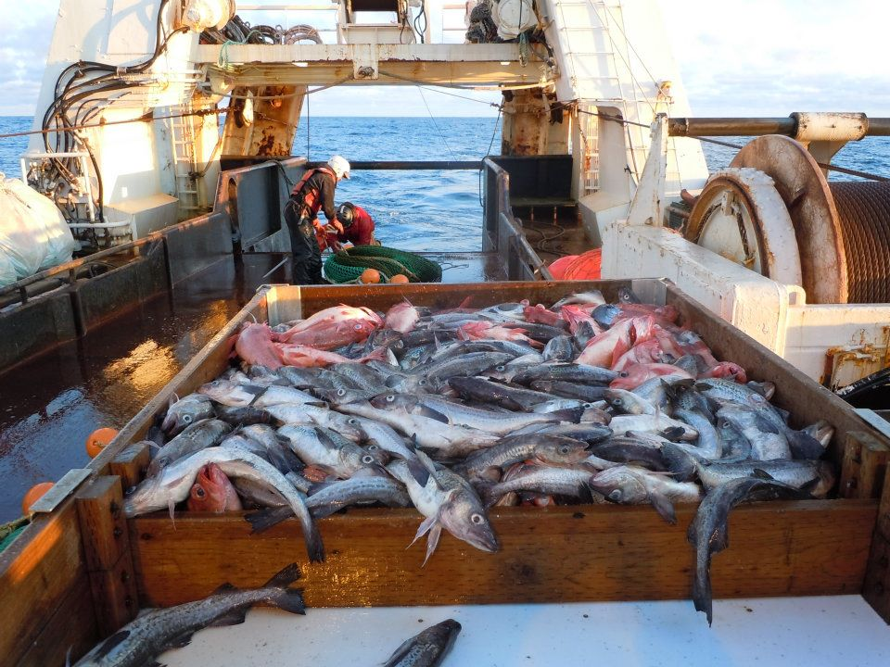
The Gauntlet
currents
temperature, nutrients
prey, predation
competition
habitat
What factors most affect how the 5 target species of groundfish get from here…
…to here?
NOAA Fisheries

Slide 4
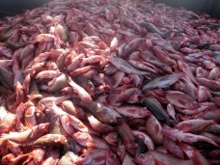
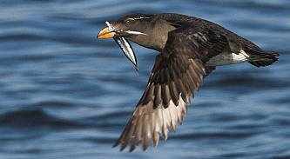
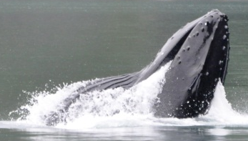
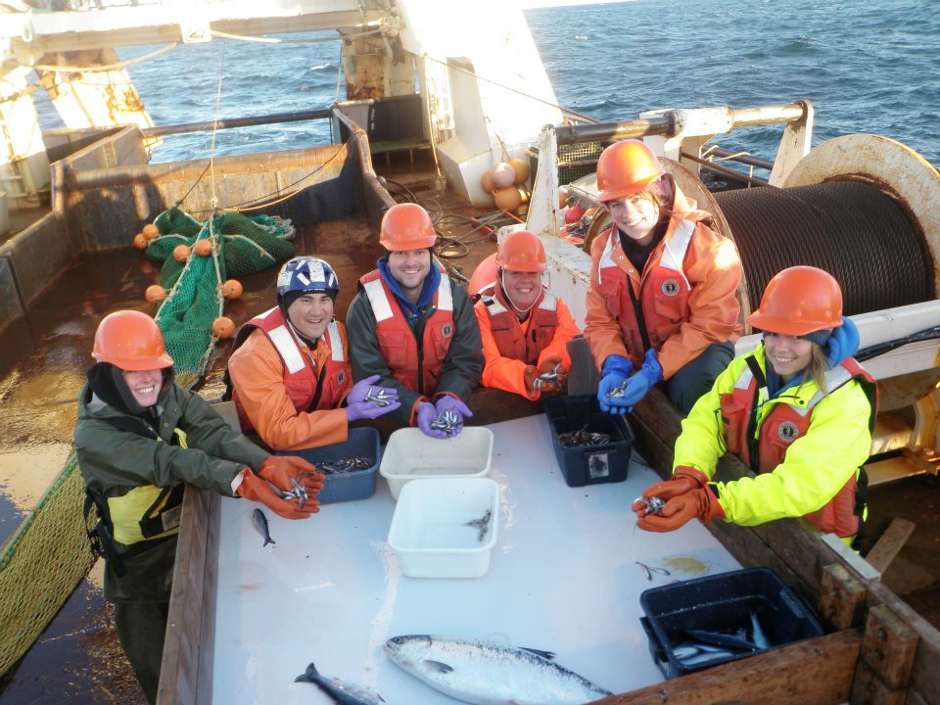
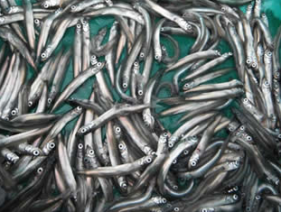
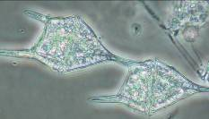
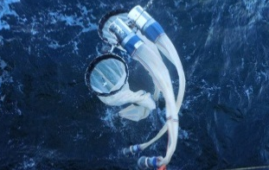
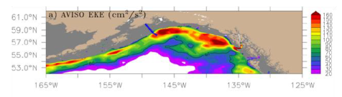
Project conceptual model
adults
seabirds &
marine mammals
5 target groundfish species
YOY & juveniles
forage fishes
eggs &
larvae
primary and secondary productivity
transport
climate & oceanography
NOAA Fisheries

Slide 5
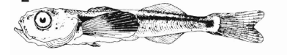

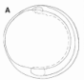
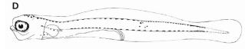

Sablefish Conceptual Model
Preliminary conceptual model (not final)
= Modeled ‘Stage’
= Indicates ‘switch’ to next ‘Stage’
SIZE
2 mm
5-6 mm SL
7-80mm SL
35mm SL
DEPTH
EPI-PELAGIC JUVENILES
JUVENILES
FEEDING LARVAE
f(SL)
f(time)
MOVE INSHORE
Nursery area
200m
ADULT SPAWN
Swim to surface
EGGS
FEEDING LARVAE
500m
Eggs Sink
EGGS
YOLK SAC
LARVAE
continental shelf
1st feeding
f(time)
Larvae
Hatch
f(time)
1000m
Function
f(time)
f(time)
f(length,age)
f(length)
TIME
t₀
t₀ + 2 weeks
t₀ + 4 weeks
Jan-March
NOAA Fisheries

Slide 6
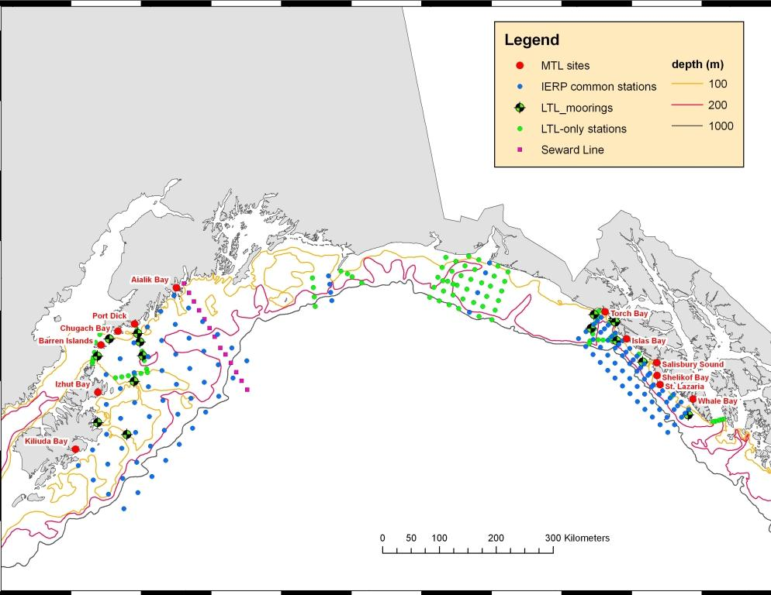
Geographic Scope
Gulf of Alaska
Regional comparisons
Broad shelf
High demersal biomass
Low species diversity
Narrow shelf
Lower biomass
High species diversity
vs.
NOAA Fisheries

Slide 7
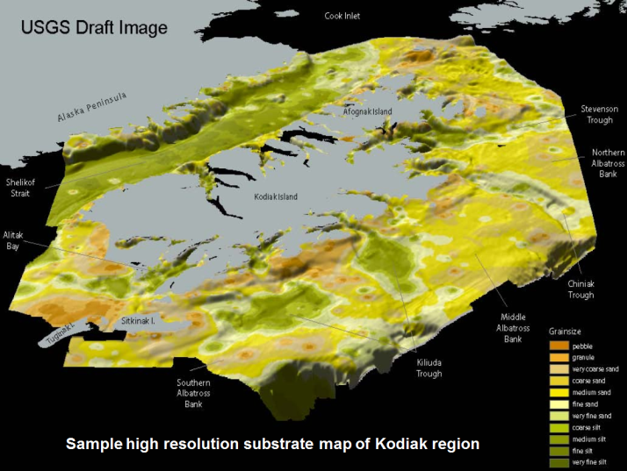
Interactions
Interactions between species vary with life stage, season and location.
Competition and predation are
influenced by
  abundance, distribution and species composition of predators and prey
  habitat requirements
NOAA Fisheries

Slide 8
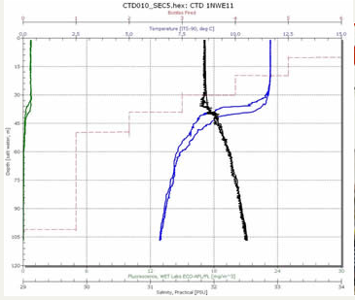

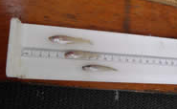
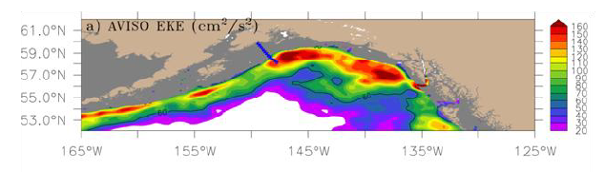
Research components
Middle trophic level
Upper trophic level
Lower trophic level
Modeling
NOAA Fisheries

Slide 9
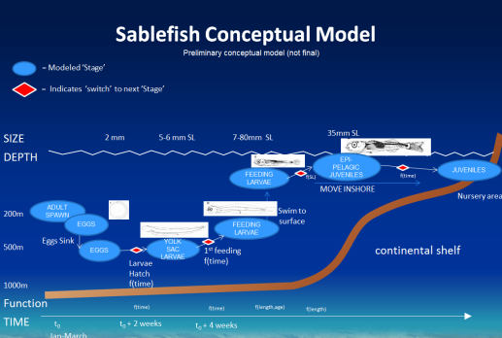

Modeling
Pattern analysis – historic data
Ocean circulation (ROMS)
Nutrient-Phytoplankton-Zooplankton
Individual-Based Models (IBM)
  Transport
  Growth
  Mortality
Multi-species models
NOAA Fisheries

Slide 10

Retrospective Analysis
  Retrospective analysis will compile available long-term time series across all ecosystem components
    Spatial-temporal analysis to reveal patterns and trends
    Support modeling effort

Slide 11
Data Management
  Data management team will develop a data and metadata clearinghouse
    web portal to facilitate data sharing for integrated analyses
    ensure timely delivery of data & metadata by all PIs
    Data management RFP out now – proposals due Dec. 14

Slide 12
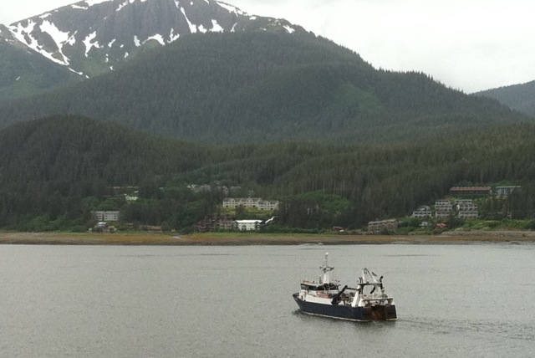
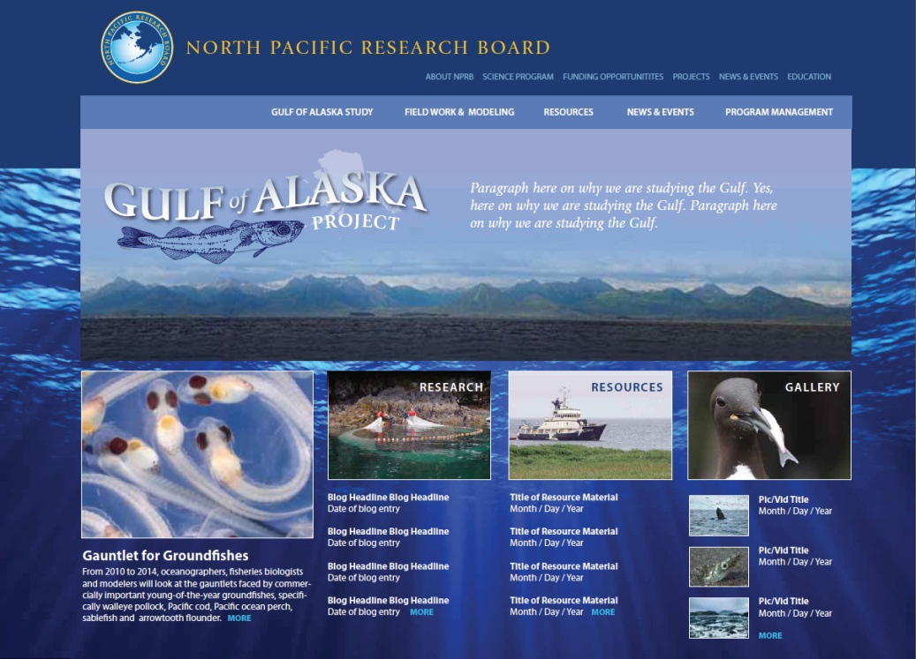
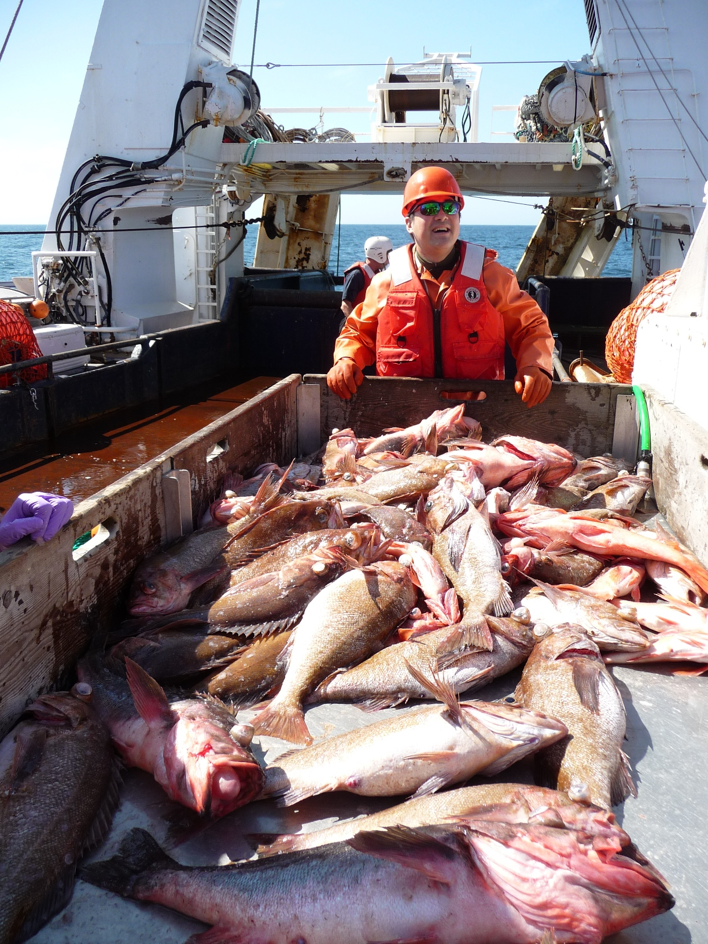
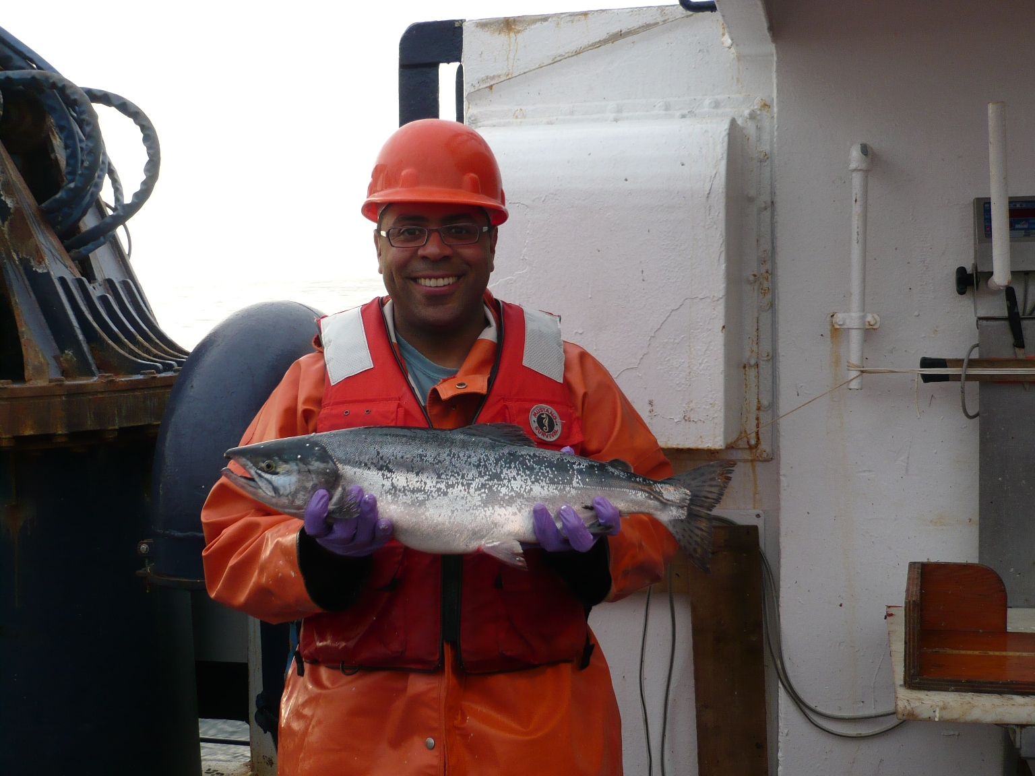
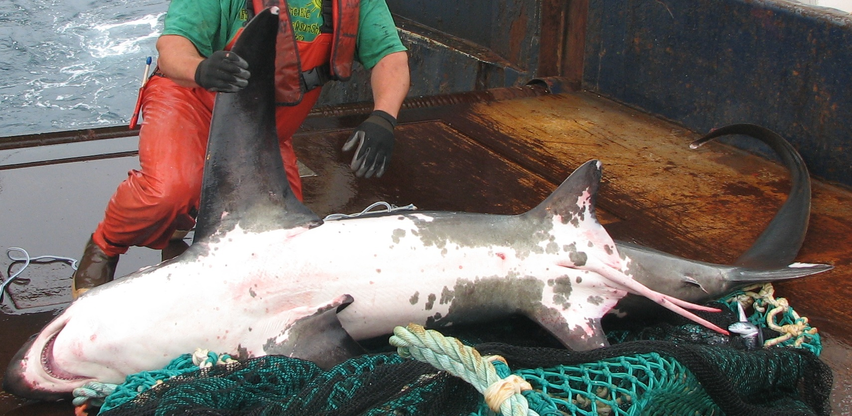
Communication,
Education and Outreach
Website
Field blogs

Slide 13

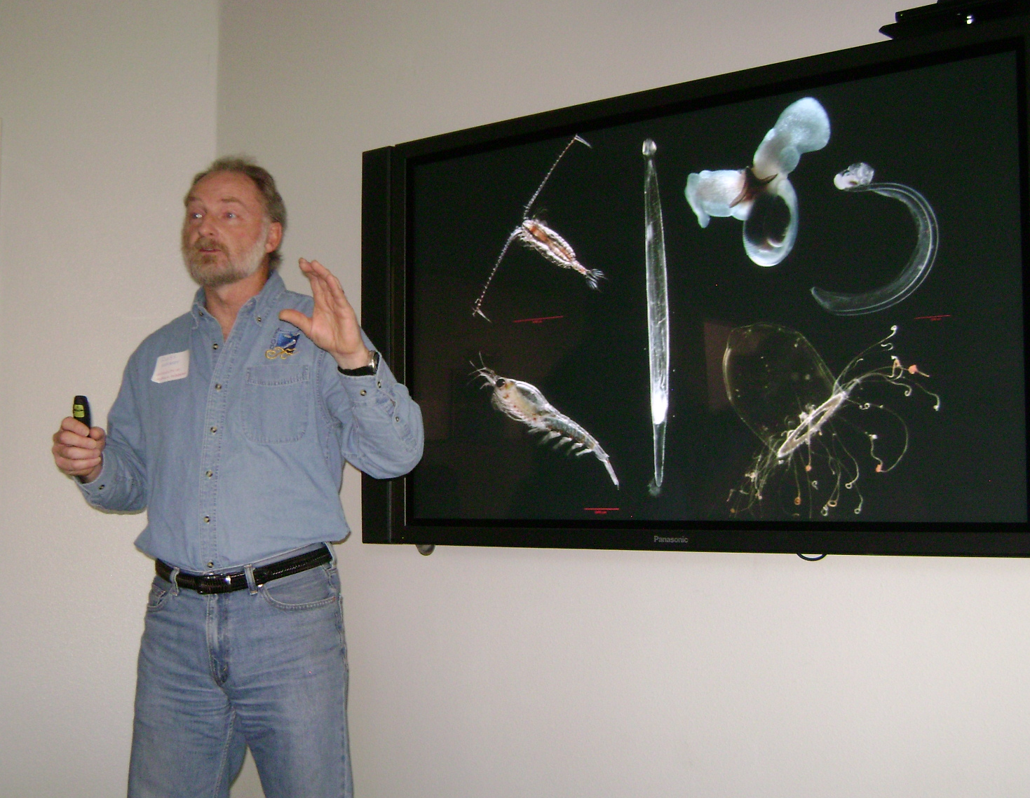
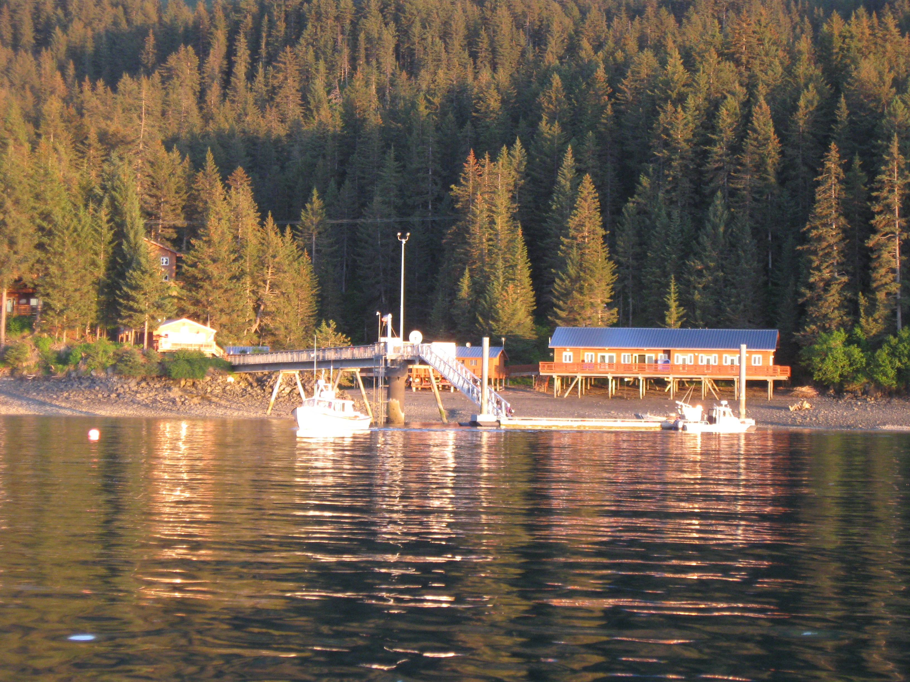
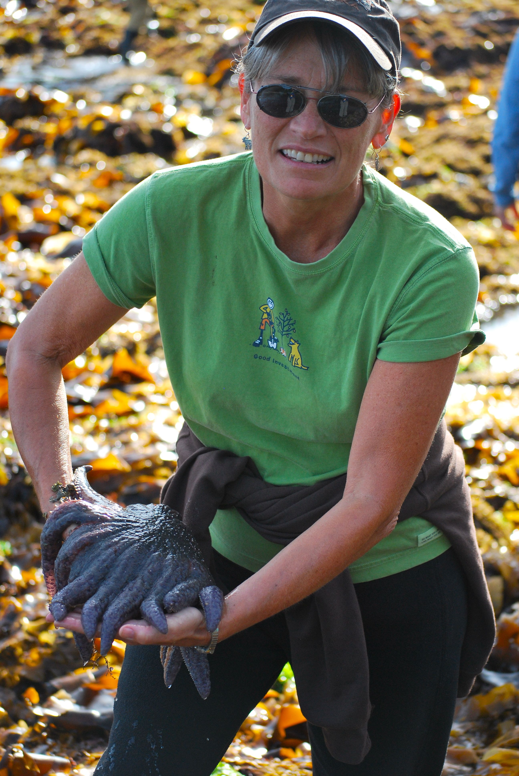
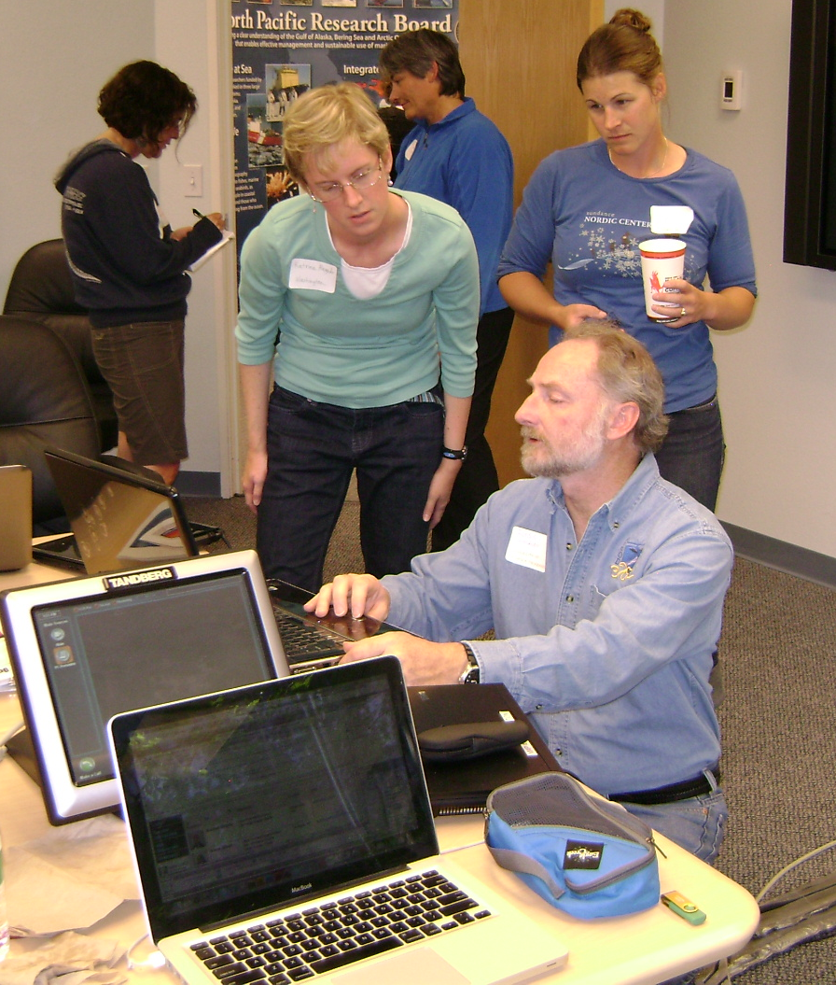

Slide 14
Gulf of Alaska Project study sites near
EVOS LTM sites
NOAA Fisheries

Slide 15
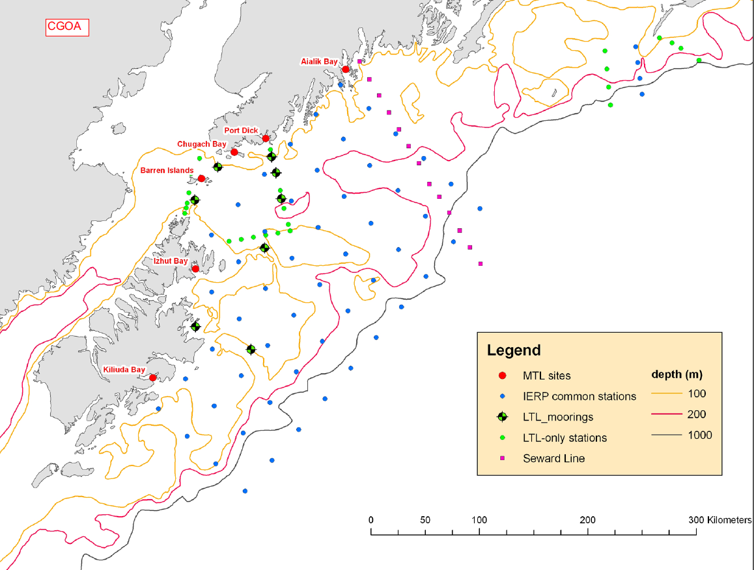
NOAA Fisheries

Slide 16
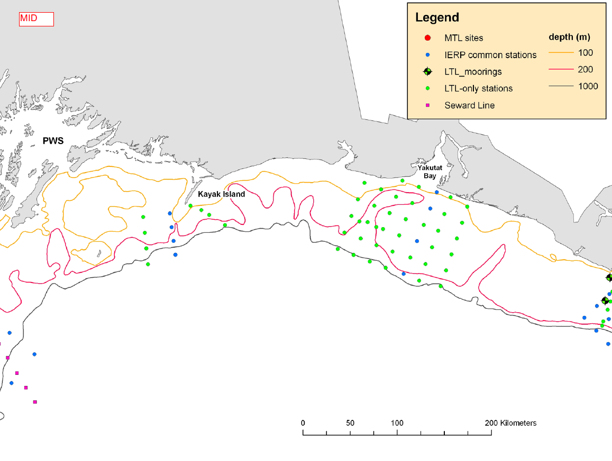
NOAA Fisheries

Slide 17
Sampling Logistics
Field seasons in 2011 and 2013
  Potential process cruise in 2012
  Seasonal data collection
    Spring (Apr – May)
    Summer (Jul – Aug)
    Fall (Sep – Oct)
Western and Eastern
Gulf of Alaska

Slide 18
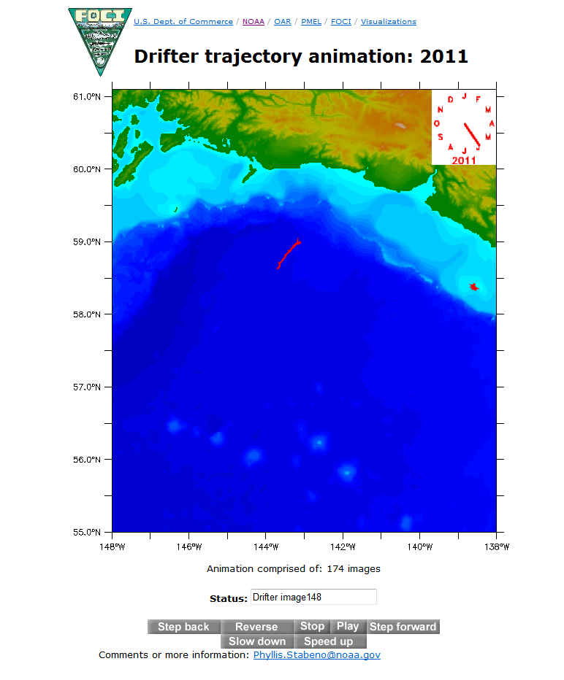
2011 Drifter animation (Yakutat)
Phyllis.Stabeno@noaa.gov
NOAA Fisheries
Notes:
http://www.pmel.noaa.gov/foci/visualizations/drifter/yaku2011.html

Slide 19
Ideas for collaborations, leveraging of resources?
NOAA Fisheries

Slide 20
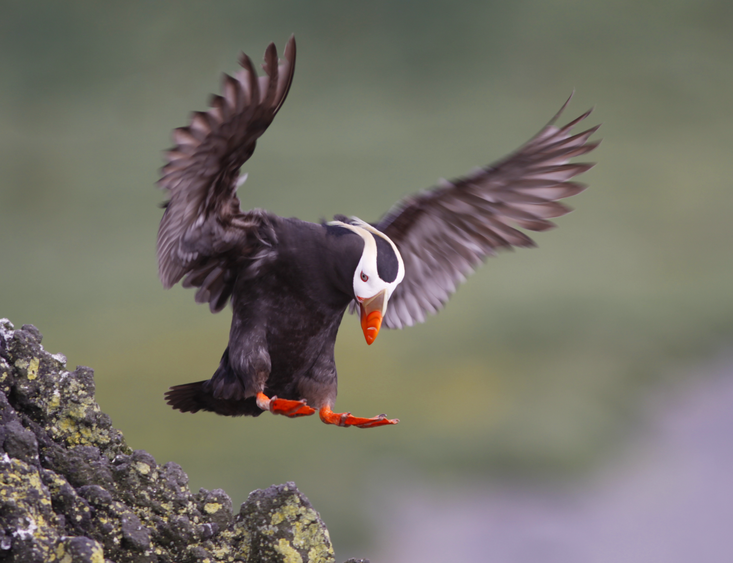
Thank you

