Slide 1
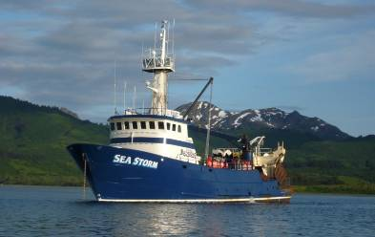
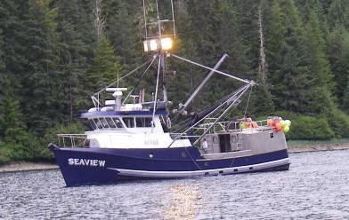
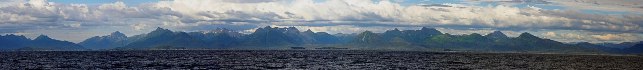
The Gulf of Alaska Project:
An Integrated Ecosystem Research Project
Georgina Gibson, Sarah Hinckley, Russ Hopcroft, Jamal Moss, and Olav Ormseth
NOAA Fisheries
Notes:
The GOA Program is an Integrated Ecosystem Research Program funded by the NPRB with the intent of bringing together a team of interdisciplinary research scientists together to improve our understanding of how the GOA functions. Should is underscored in my title because 1. salmon were not included as a target species 2. they are an important player in the GOA ecosystem, and 3. this project provides great spatial and temporal coverage to support salmon ocean ecology work

Slide 2
A. Aguilar-Islas (UAF)
S. Atkinson (UAF)
K. Aydin (NOAA)
S. Budge (Dalhousie U.)
B. Coffin (UAF)
K. Coyle (UAF)
N. Deans (NPRB)
A. DeRobertis (NOAA)
D. Dickson (NPRB)
M. Doyle (UW)
J. Duffy-Anderson (NOAA)
W. Fournier (NOAA)
K. Frederickson (WWU)
G. Gibson (UAF)
N. Golden (USGS)
M. Guttormsen (NOAA)
L. Guy (UW)
K. Hedstrom (UAF)
J. Heifetz (NOAA)
R. Heintz (NOAA)
A. Hermann (UW)
S. Hinckley (NOAA)
R. Hopcroft (UAF)
J. Horne (UW)
N. Kachel (UW)
C. Ladd (NOAA)
A. Matarese (NOAA)
D. McGowan (UW)
C. Mordy (UW)
J. Moss (NOAA)
F. Mueter (UAF)
J. Napp (NOAA)
O. Ormseth (NOAA)
C. Parada (IIP)
K. Rand (NOAA)
J. Reid (USGS)
R. Rember (IARC)
K. Shotwell (NOAA)
L. Slater (USFWS)
P. Stabeno (NOAA/PMEL)
W. Stockhausen (NOAA)
D. Stockwell (UAF)
S. Strom (WWU)
P. Sullivan (UW)
J. Vollenweider (NOAA)
J. Waite (UAF)
S. Wang (S. Ecological)
F. Wiese (NPRB)
C. Wilson (NOAA)
M. Zimmerman (NOAA)
NOAA Fisheries

Slide 3

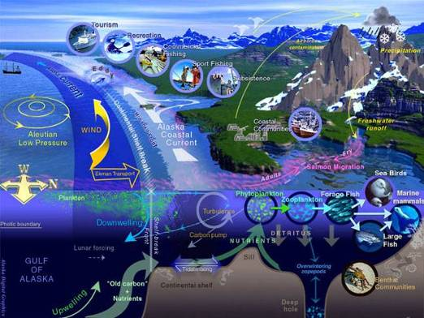
Scope & Breadth
“How do environmental and anthropogenic processes, including climate change, affect trophic levels and dynamic linkages among trophic levels, with emphasis on fish and fisheries, marine mammals, and seabirds within the Gulf of Alaska”
NOAA Fisheries
Notes:
The Gulf of Alaska Project is the second integrated ecosystem research project that NPRB has commissioned. I’m sure many of you are familiar with the Bering Sea IERP or BSIERP; which is a partnership between NPRB and NSF, and has been very successful in increasing our understanding of how ice influences the Bering Sea ecosystem and recruitment dynamics of marine fish. NPRB’s vision for this program was one that would “investigate environmental and anthropogenic processes, including climate change, affect trophic levels and dynamic linkages among trophic levels, with emphasis on fish and fisheries, marine mammals, and seabirds within the Gulf of Alaska”.

Slide 4

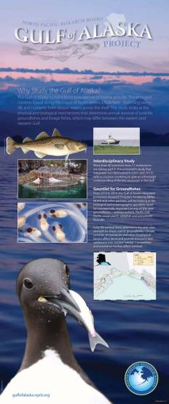
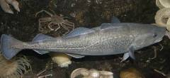
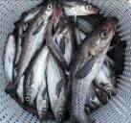
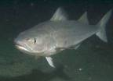
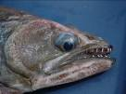

Interdisciplinary Study
  $17.5 million-study
  5 years (2010 – 2014)
  >40 scientists from 11 institutions
Gauntlet for Groundfishes
  Sablefish
  Walleye pollock
  Pacific ocean perch
  Pacific cod
  Arrowtooth flounder
NOAA Fisheries
Notes:
And what NPRB got was a 17.5 million dollar study over 5 years that involves over 40 scientists from 11 different institutions.
And a project that focuses on ATF, P. cod, Pollock, rockfish, and sablefish because they are the majority of predator biomass in the GOA and display a variety of life-histories.

Slide 5
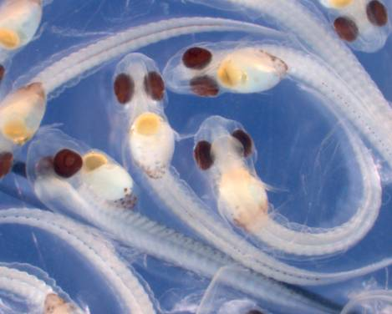
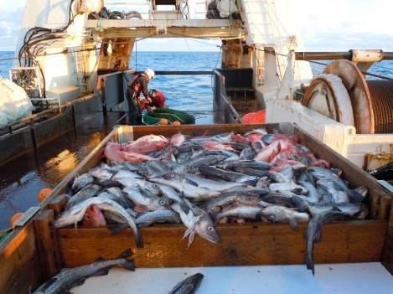
The Gauntlet
currents
temperature, nutrients
prey, predation
competition
habitat
What factors most affect how the 5 target species of groundfish get from here…
…to here?
NOAA Fisheries
Notes:
In many instances groundfish recruitment in the Gulf of Alaska appears to be less related to fishing pressure and spawning biomass, which infers a strong environmental effect.
Focus on the YOY stage, as it is a critical period for survival.

Slide 6

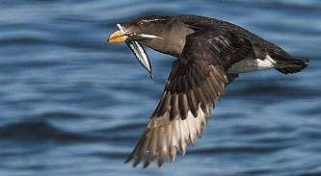
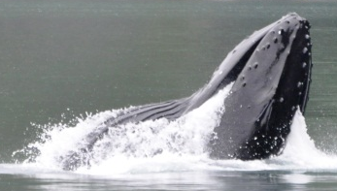
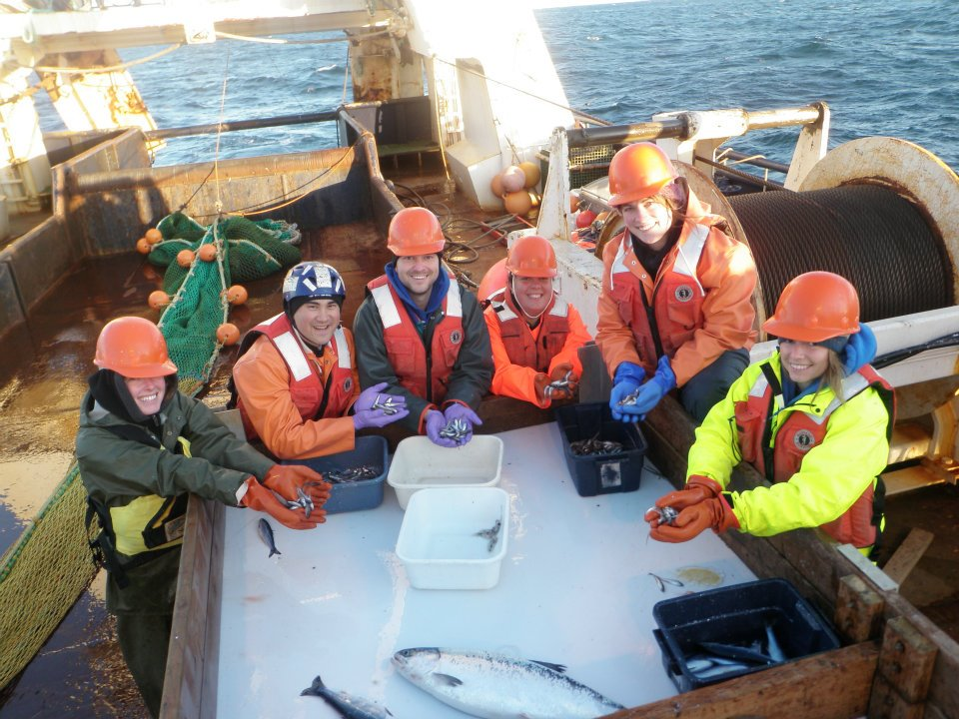
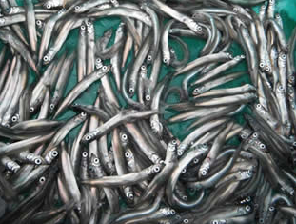




Project Conceptual Model
adults
seabirds &
marine mammals
5 target groundfish species
YOY & juveniles
forage fishes
eggs &
larvae
primary and secondary productivity
transport
climate & oceanography
NOAA Fisheries
Notes:
So we’ve designed a study that tracks the health and abundance of 5 target groundfish species from larval to adults while accounting for transport by ocean currents, prey resources, competitors and predators.

Slide 7
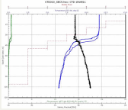
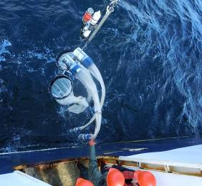
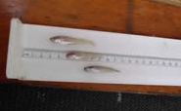
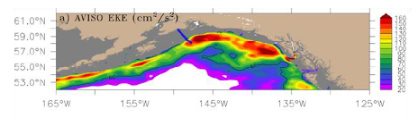
Research Components
Middle Trophic Level
Upper Trophic Level
Lower Trophic Level
Modeling
NOAA Fisheries
Notes:
The four primary research components of this program are the LTL, MTL, UTL, and Modeling component. The LTL is focused on oceanography and plankton, the MTL with nearshore marine fish and ecology and forage fish interactions, the UTL is focused on marine fish ecology, physiology, and habitat, and the modeling with pattern analysis, ocean circulation, Nutrient-Phytoplankton-Zooplankton dynamics, Individual based models, and multi-species models.
The rest of the talk will focus on specific findings and activities from each component in order to give you a taste of what the project is all about; and then end with an overview.

Slide 8
Retrospective Analysis Group
Historical datasets
  Identified 100 historical datasets
Baseline information on ecosystem processes
Identify mechanisms influencing recruitment
Identify long-term regional trends
All trophic level components
NOAA Fisheries
Notes:
We also have a retrospective analysis group that cuts across the 4 primary research components, is comprised of representatives from each of these groups, and is lead by Franz Mueter. The retrospective group is tasked with analyzing historical data sets to extract baseline information on ecosystem processes, identify mechanisms that influence recruitment, and identify long-term trends.
Their findings will guide the rest of us as we move forward in the project and evaluate hypotheses and assumptions.

Slide 9
SST Variability (EOF analysis)
First mode (EOF 1, 70.8%)
Second mode (EOF 2, 9.2%)
F. Mueter (UAF)
Notes:
The retrospective group has identified distinct differences in the biology and underlying processes between the eastern and central GOA. This slide shows results from a Principal Component Analysis of sea surface temperature. In general the entire Gulf is uniformly warm or cool as shown by the figure to your left. However, there is an underlying trend relative to the average where one side is consistently warmer than the other with a transition zone somewhere around 145° W. The figure to your right shows one year’s worth of data where temperature is anomalously warm in the east, and cool in the west.

Slide 10
Spatial Patterns in Chl. a Anomalies
K-means cluster analysis suggests 3 relatively distinct regions!
Jason Waite will give an in-depth analysis of Chl. a data Thursday @11:15
F. Mueter (UAF)
Notes:
Using a cluster analysis technique the retrospective analysis team has been able to discern 3 distinct regions where phytoplankton production is generally uniform in blue, green, and turquoise. We are also beginning to identify the drivers of this production.
Jason Wait is the post doc working with chlorophyll data and he will be giving a talk on Thursday at 11:15 am and will report on interesting production dynamics in the eastern Gulf.

Slide 11
Notes:
Mention something about east/west hypothesis…
This figure is an ordination of National Marine Fisheries Service bottom trawl species composition east (in black) and west (in red) of 147° W which is a management boundary. One can see there is a fairly distinct difference to either side.

Slide 12
East-West Gradients in Groundfish CPUE (-) and Species Diversity (-)
Breakpoint
at ~148 ºW
Species diversity
(Shannon-Wiener)
Normalized scale
Catch-per-unit-effort (all species)
Alongshore distance (*100 km)
F. Mueter (UAF)
Notes:
This plot shows smoothed trends in total groundfish catch per unit effort in NMFS bottom trawl survey and an index of species diversity. It shows that we have identified the location of the faunal break around 149° W, which also happens to overlap with the GAK line.
So, as originally hypothesized, we have found significant breaks between the eastern and western GOA in several environmental variables between 143-150° W!

Slide 13
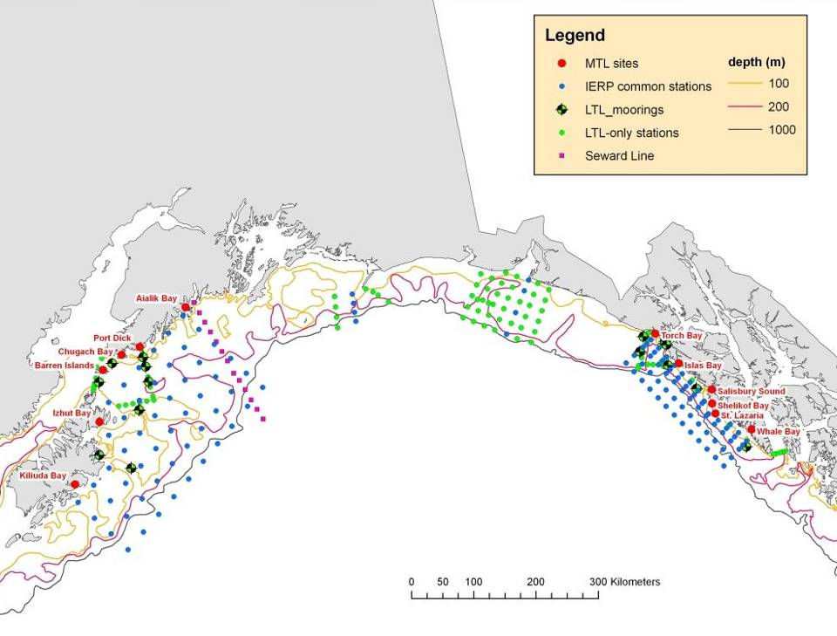
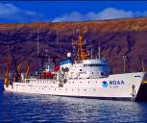
Summer & Fall Field Surveys
Gulf of Alaska
NOAA Fisheries
Notes:
One aspect of the field work for this project are summer and fall fisheries oceanographic surveys in the eastern and western study regions which is either sampled with a NOAA ship or contract vessel.

Slide 14
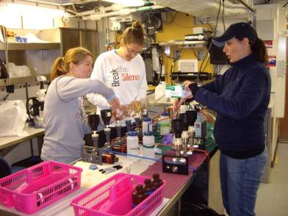
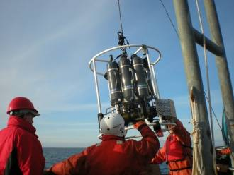
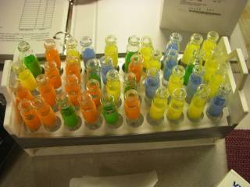
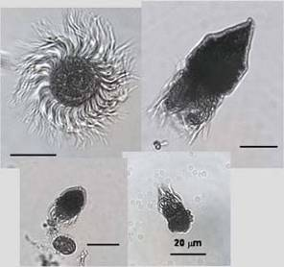
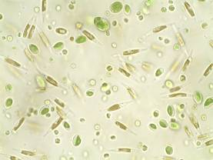
Oceanography:
Nutrients
CTD
Microzooplankton
Phytoplankton
Chlorophyll - a
http://www.dtplankton.com/images/PRB-1.jpg
http://bioloc.coas.oregonstate.edu/SherrLab/GLOBECposterciliates.jpg
NOAA Fisheries
Notes:
The vessel serves as a platform for oceanographic sampling

Slide 15
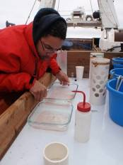
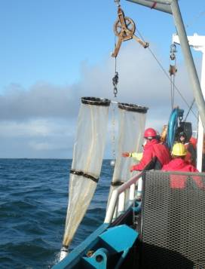
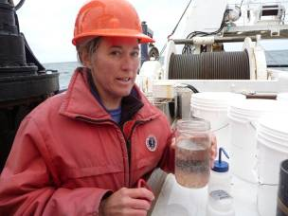
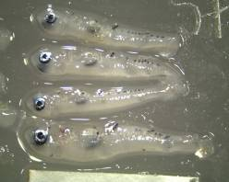
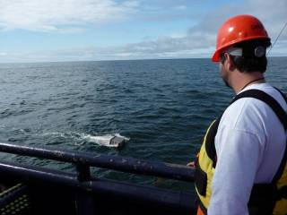
Zooplankton & Ichthyoplankton
Bongo
60cm 505 µm Oblique
Bongos
20cm 153 µm oblique
Zooplankton
Neuston
30x50cm
Larval Fish
NOAA Fisheries
Notes:
zooplankton and Ichthyoplankton collection

Slide 16
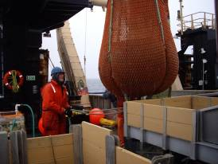
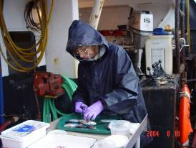
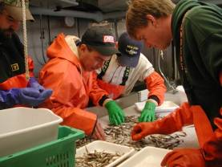
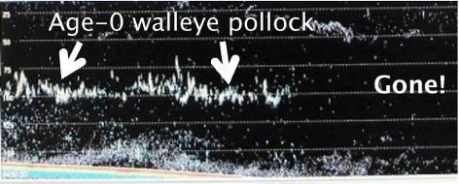
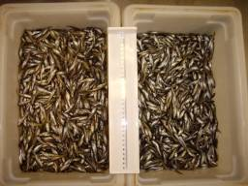
Fish & Acoustics
Fish Abundance
Diet
Caloric Content / Lipid
Surface / midwater
Rope Trawl (Top 25m)
Midwater Acoustics
Age-0 Fish
P.Cod
Pollock
NOAA Fisheries
Notes:
fish sampling with a pelagic rope trawl and acoustics

Slide 17
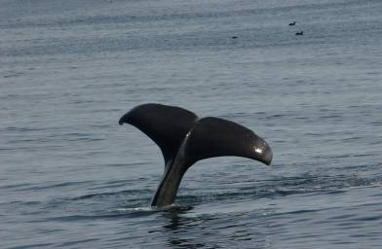
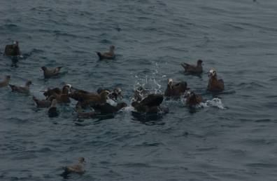


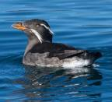
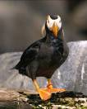

Seabirds & Marine Mammals:
At-sea Observations
Colony Observations
Rhinoceros auklet
Tufted Puffin
Storm Petrel
Diet
GPS Tag
NOAA Fisheries
Notes:
and ship-board observations of marine mammals and seabirds. We also have shore-based observations occurring at East Amatuli Island in the west and St. Lazaria in the east.

Slide 18
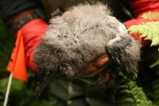

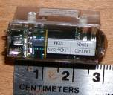
2011 Shore-based Seabird Diet
L. Slater (USFWS)
NOAA Fisheries
Notes:
Seabirds act as autonomous samplers of the environment for both fish and plankton.
Rhinoceros auklets are pisciverous birds that bring whole prey back to their young allowing for them to be good. In 2011 rhinoceros auklets the western region (St. Amatuli Is.) primarily consumed capelin and larval fish, whereas in the eastern region (St. Lazaria Is.) they focused on a variety of forage fish.
This figure represents about half of the samples. The rest will be analyzed this winter.
Our salmon predators were also focusing on capelin in the western region.

Slide 19
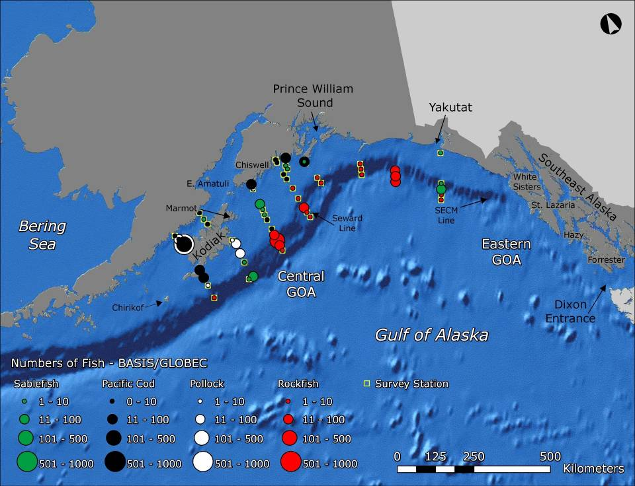
Notes:
This slide shows summer catches of age-0 sablefish, Pacific cod, Pollock, and rockfish in the western study region from the GLOBEC program (2001-2004).

Slide 20
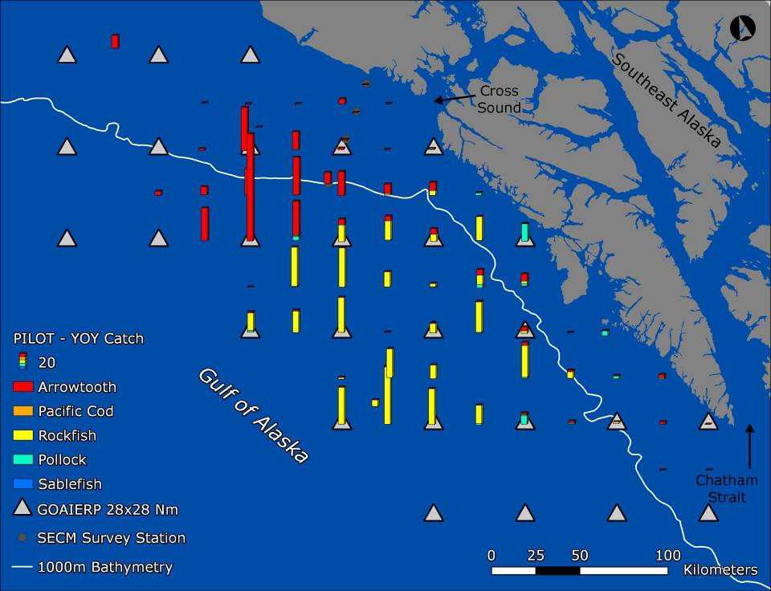
2010 Pilot Survey
NOAA Fisheries
Notes:
And here we have summer catches of age-0 arrowthooth flounder, rockfish, and a few Pollock in the eastern study region during 2010 pilot survey

Slide 21
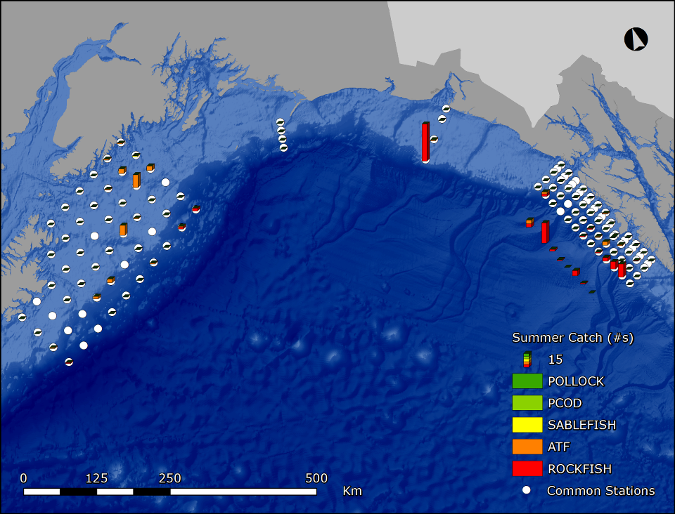
Summer
Wyatt Fournier poster on larval & juv. Rockfish distribution and predation by adult salmon
NOAA Fisheries
Notes:
But in 2011 catches for all focal species were low in both regions. Also, Wyatt Fournier has a poster that examines age-0 rockfish distributions and adult salmon predation upon them.

Slide 22
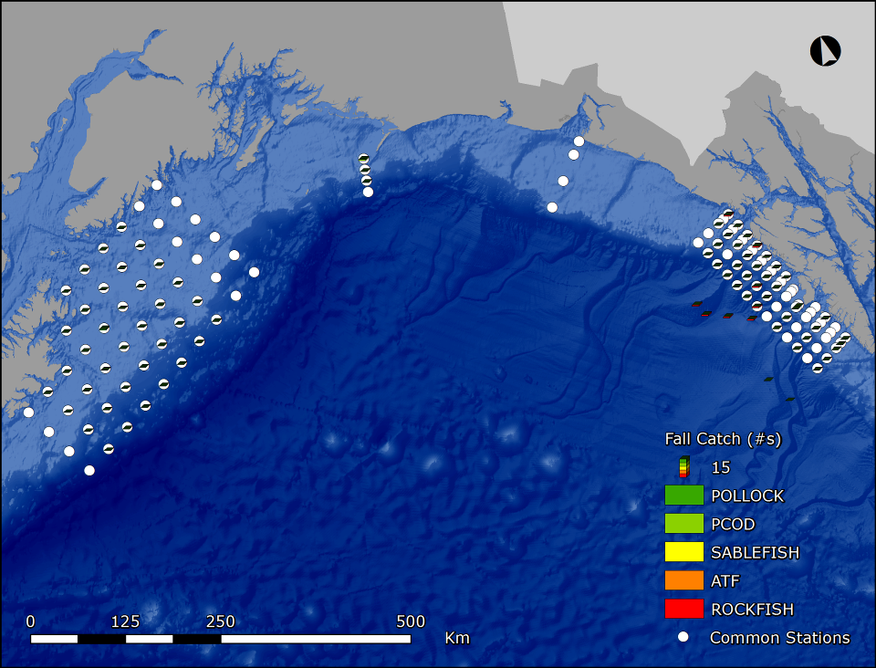
Fall
NOAA Fisheries
Notes:
By fall we do not encounter our target species, as they have settled out nearshore and are associated with the benthos.

Slide 23
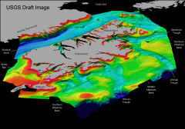
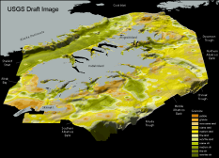
Habitat Mapping
Hypothesis
  Settlement to preferred habitat is one of the critical regulators of early life survival throughout the offshore to nearshore gauntlet
Goal
  Characterize offshore to nearshore benthic habitat by region
Objectives
  Collect, clean, digitize, and grid available bathymetry, sediments, and habitat features
  Create base models of species specific preferred habitat and generate suitability maps for use in nearshore IBMs
Kalei Shotwell has a poster on benthic habitat research
NOAA Fisheries
Notes:
Settlement into the proper and suitable nearshore habitat is the next the stage of the gauntlet, and an important factor of overwinter survival.
We are digitizing available data on bathymetry, sediments, and habitat features; and then creating base models of species specific preferred habitat that will be combined with surface grids to generate habitat suitability maps. These maps will be integrated with the modeling component IBMs
Kalei Shotwell has a poster on bentic habitat work if you’d like to learn more.

Slide 24
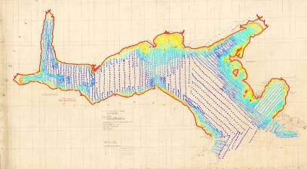
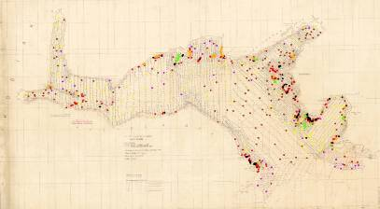


Kiliuda Bay Example
Bathymetry
Sediments & Features
Meters
0
10
25
50
100
Sediments
Rocky
Gravel
Sand
Mud
Features
Rock
Islet
Floating kelp
Rocky outcrop
Seafloor Measures
Example Habitat Map
40m
79,300 m²
87,600 m²
Cross-sections
Norcross et al. 1997
Preferred Habitat Age-0 Flathead sole:
80-120 m, mud, central areas
306,600 m²
Mean Low Low Water
Courtesy of Mark Zimmermann, AFSC
NOAA Fisheries
Notes:
Here is an example from Kiliuda Bay. Raw bathymetry and sediments are featured on the top two panels. The bottom left shows gridded bathymetry and the bottom right panel is an example of suitable habitat for young of the year flathead sole.

Slide 25



MTL Overview
nearshore survey w/ acoustics
offshore acoustics (UTL platform)
diet analysis: stomachs, FA, SI
condition and energy content
NOAA Fisheries

Slide 26



MTL Nearshore Survey Sites
Kenai Peninsula
Aialik Bay
Torch Bay/
Graves Harbor
Port Dick
Barren Islands
Islas Bay
Salisbury Sound
Izhut Bay
Kodiak
Island
St. Lazaria
Kiliuda Bay
Whale Bay
NOAA Fisheries
Notes:
Talk a bit about criteria for selecting sites

Slide 27




MTL Platforms
Pics and detail on methods
NOAA Fisheries

Slide 28

Nearshore Surveying, MTL-style
NOAA Fisheries

Slide 29



MTL Purse Seine Catches
NOAA Fisheries

Slide 30



LTL Overview
Spring: LTL-only oceanography cruises
Summer/fall: UTL platform oceanography
Moorings
Drifters
Iron studies
NOAA Fisheries

Slide 31

LTL Sampling Design
NOAA Fisheries

Slide 32

LTL Sampling Design - Intensive
NOAA Fisheries

Slide 33

LTL: Spring 2011 Surface Chlorophyll
NOAA Fisheries

Slide 34
Modeling Overview
Effect of environmentally
Effect of environmentally
-
-
caused variability in
caused variability in
recruitment on ecosystems components and fishing
recruitment on ecosystems components and fishing
Multi Species Model
Multi Species Model
Habitat maps
Habitat maps
Distribution
UTL
Distribution
UTL
of juveniles
Component
of juveniles
Component
nursery areas,
nursery areas,
diet,
diet,
abundance,
Indices of recruitment
abundance,
Indices of recruitment
production and
production and
Retrospectiv
consumption
Retrospectiv
consumption
MTL
MTL
e
e
Recruitment
Sablefish
Recruitment
Sablefish
Forage fish diet,
Pollock
Forage fish diet,
Pollock
Arrowtoot
ATF
Component
Component
correlations
abundance,
correlations
h
abundance,
production and
Offline
production and
Pacific Cod
Offline
Pacific Cod
POP
POP
consumption
IBM Models
consumption
H3
IBM Models
H3
Distribution of
H3
Distribution of
H3
competitors and
Initial Larval
competitors and
Initial Larval
juveniles
Distributions
juveniles
Distributions
LTL
Hydrography and ,zooplankton biomass
LTL
Hydrography and ,zooplankton biomass
Component
H2
Component
H2
H2
H2
Plankton
Indices of
Plankton
Indices of
process rates
Lower Trophic Level Model
process rates
LTL
Lower Trophic Level Model
LTL
variability
variability
nested GOA
nested GOA
-
-
NPZ
H1
NPZ
H1
H1
H1
Plankton
Plankton
Larval
Hydrography
Larval
Hydrography
Oceanographic
Indices of
Oceanographic
Indices of
biomass,
biomass,
horizontal
Data
horizontal
physical
Data
physical
Nutrients,
Nutrients,
and vertical
ROMS Physical Ocean Model
and vertical
UTL
ROMS Physical Ocean Model
UTL
variability
Modeling
variability
Modeling
Production
Production
distribution
GOA Grid 3km
distribution
Component
GOA Grid 3km
Component
Component
Hypotheses
Component
Hypotheses
Hypotheses
Hypotheses
Boundary and Initial Conditions
Decision of
Boundary and Initial Conditions
Decision of
Regional
EOF
Regional
EOF
Longitudinal
which runs
Longitudinal
which runs
statistical
Analysis,
statistical
Analysis,
+ trajectory
ROMS Physical Ocean Model
+ trajectory
ROMS Physical Ocean Model
indices
Regional
indices
Regional
analysis,
statistical
analysis,
Regime
statistical
Regime
Genetics
GOA Grid 10km
Genetics
GOA Grid 10km
indices
analysis
indices
analysis
Model
NPZ
Model
ROM
NPZ
ROM
IBM
IBM
’
’
s
S
s
Atmospheric forcing products
S
Atmospheric forcing products
Vertically Linked Models
Vertically Linked Models
Model
Model Validation
NOAA Fisheries

Slide 35
Modeling Overview
Effect of environmentally
Effect of environmentally
-
-
caused variability in
caused variability in
recruitment on ecosystems components and fishing
recruitment on ecosystems components and fishing
Environmental Effect on Recruitment
Multi Species Model
Multi Species Model
Habitat maps
Habitat maps
Distribution
UTL
Distribution
UTL
of juveniles
Component
of juveniles
Component
nursery areas,
nursery areas,
diet,
diet,
abundance,
Indices of recruitment
abundance,
Indices of recruitment
production and
production and
Retrospectiv
consumption
Retrospectiv
consumption
MTL
MTL
e
e
Recruitment
Sablefish
Recruitment
Sablefish
Forage fish diet,
Pollock
Forage fish diet,
Pollock
Arrowtoot
ATF
Component
Component
correlations
Multi-Species Models
abundance,
correlations
h
abundance,
Field Observations
production and
Offline
production and
Pacific Cod
Offline
Pacific Cod
POP
POP
consumption
IBM Models
consumption
H3
IBM Models
H3
Distribution of
H3
Distribution of
H3
competitors and
Initial Larval
competitors and
Initial Larval
juveniles
Distributions
juveniles
Distributions
LTL
Hydrography and ,zooplankton biomass
LTL
Hydrography and ,zooplankton biomass
Component
H2
Component
H2
H2
H2
Plankton
Indices of
Plankton
Indices of
process rates
Lower Trophic Level Model
process rates
LTL
Lower Trophic Level Model
Hypothesis Testing
LTL
variability
variability
nested GOA
nested GOA
-
-
NPZ
H1
NPZ
H1
H1
H1
Individual Based Fish Models
Plankton
Plankton
Larval
Hydrography
Larval
Hydrography
Oceanographic
Indices of
Oceanographic
Indices of
biomass,
biomass,
horizontal
Data
horizontal
physical
Data
physical
Nutrients,
Nutrients,
and vertical
ROMS Physical Ocean Model
and vertical
UTL
ROMS Physical Ocean Model
UTL
variability
Modeling
variability
Modeling
Production
Production
distribution
GOA Grid 3km
distribution
Component
GOA Grid 3km
Component
Component
Hypotheses
Component
Hypotheses
Hypotheses
Hypotheses
Boundary and Initial Conditions
Decision of
Boundary and Initial Conditions
Decision of
Regional
EOF
Regional
EOF
Longitudinal
which runs
Longitudinal
which runs
statistical
Analysis,
statistical
Analysis,
+ trajectory
ROMS Physical Ocean Model
+ trajectory
ROMS Physical Ocean Model
indices
Regional
indices
Regional
analysis,
statistical
analysis,
Regime
statistical
Regime
Genetics
GOA Grid 10km
Genetics
GOA Grid 10km
indices
analysis
indices
analysis
Model
Physical Forcing & Lower Trophic Level Models
NPZ
Model
ROM
NPZ
ROM
IBM
IBM
’
’
s
S
s
Atmospheric forcing products
S
Atmospheric forcing products
Vertically Linked Models
Vertically Linked Models
Model
Model Validation
Regime Analysis
Model Validation
NOAA Fisheries

Slide 36

Modeling Results: Pattern Analysis
purpose is to identify regimes for hindcasting
main pattern seen relates to “Gyre Spinup”, and El Niño/PDO (strong/weak).
seen especially in along shelf velocities, EKE, SSH and SST
NOAA Fisheries

Slide 37

Example: Pacific Cod Conceptual Model
= Modeled ‘Stage’
= Indicates ‘switch’ to next ‘Stage’
Size at hatch:
3-4 mm SL
Flexion:
10-17 mm
Transformation:
25-35mm
YOLK SAC
LARVAE
FEEDING LARVAE
EPI-PELAGIC JUVENILES
1st feeding
f(???)
Diel Migration (after flexion)
JUVENILES
Larval Depth: shallower when cold.
YSL: Swim to surface, T=hatch+ 1 day
MOVE INSHORE
Nursery area
Egg Development: f(time,temp,
depth,substrate)
ADULT SPAWN
EGGS
Hatch:
f(time,temp)
Spawn:
Feb-July
(t₀)
Hatch:
t₀ + 21-26 days
at 4˚C
t₀ + 4 weeks
July+
TIME
NOAA Fisheries

Slide 38
Summary
Comprehensive look at all trophic levels of the GOA ecosystem, from the shoreline out to beyond the shelf break
Focused on the environmental gauntlet that five major groundfish species must navigate during early life
Comparative approach: eastern vs. western GOA, seasonal and annual variability
NOAA Fisheries

Slide 39


NOAA Fisheries

